Slide 1
Capstone Project
Mobile Price Range Prediction Team member Biswajeet sethi PVN malleswara Rao Sanjay P Malviya

Slide 2
How Price Range affected by different features of Mobiles
Let’s explore how different features of a mobile affects its price
1. Premise
2. Objective
3. Data pipeline/pre-processing
4. EDA
5. Models
8. Prediction metrics
9. Conclusion

Slide 3

Premise
Mobile Phone market is very huge. At the same time the Competition in the mobile manufacturing is also very high. At this cross juncture the mobile manufacturing companies prefer to understand, analyse and get insights from the current datasets of models of mobiles. Mobile Manufacturing companies try to get the relation between the features and the price ranges.

Slide 4

OBJECTIVE
● Price of a mobile phone is influenced by various
factors. Brand name, newness of the model,
specifications such as internal memory, camera,
ram, sizes, connectivity etc., are some of the
important factors in determining the price. As a
business point of view, it becomes an utmost
priority to analyse these factors from time to time
and come up with best set of specifications and
price ranges so that people buy their mobile phones.
● Hence, through this exercise and our predictions
we will try to help companies estimate price of
mobiles to give tough competition to other mobile
manufacturer and also it will be useful for customers
to verify that they are paying best price for a mobile.

Slide 5
Data Summary
● The dataset contains 2000 rows and 21 columns.
● The contents of the data had these features:
○ Battery_power - Total energy a battery can store in one time measured in mAh
○ Clock_speed - speed at which microprocessor executes instructions
○ Fc , Pc - Front and Primary Camera megapixels
○ Int_memory - Internal Memory in Gigabytes
○ M_dep - Mobile Depth in cm
○ Mobile_wt - Weight of mobile phone
○ N_cores - Number of cores of processor
○ Px_height, Px_width - Pixel Resolution Height and Width
○ Ram - Random Access Memory in Megabytes
○ Sc_h, Sc_w - Screen Height and width of mobile in cm
○ Talk_time - longest time that a single battery charge will last when you are on call
○ Blue, 4g, 3g, dual_sim, touchscreen, wifi - Some supported and unsupported categories
○ Price_range - This is the target variable with value of 0(low cost), 1(medium cost), 2(high cost) and 3(very highcost).

Slide 6
Data Pipeline
Understanding the Data:
In this part we go through each columns, differentiate independent and dependent feature. Getting what are the kinds of features present in the dataset.
Data cleaning:
In this process identify the errors and corruptions and either remove or manually replace with mean median and mode values and correct the data type. Checking for null values and duplicates.
EDA:
we do some exploratory data analysis(EDA) to get some insight into data set and underlying structure of data set on selected features , visualize the data using different plots.

Slide 7
Models
1. Data splitting:
Before proceeding to pass the data to models, the data is split into the training
dataset and the testing dataset.
2. Logistic Regression:
We trained the Logistic Regression model with the training dataset and tested
with the test Dataset.
3. Decision Tree:
We trained the Decision Tress using the training dataset and predicted the
Test Dataset.
4. Random Forest/XGBoost:
We trained the Random forest classifier and XGBoost using the training
Dataset and predicted the Test Dataset and stored the values in a different
Dataframe.

Slide 8
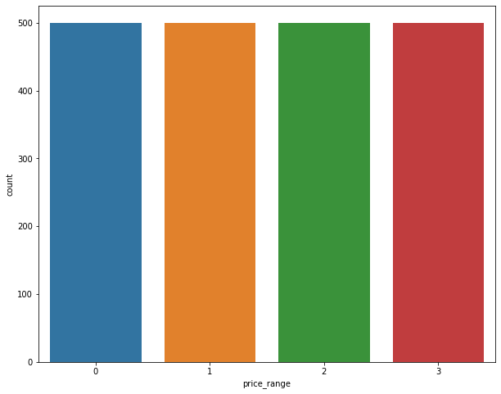
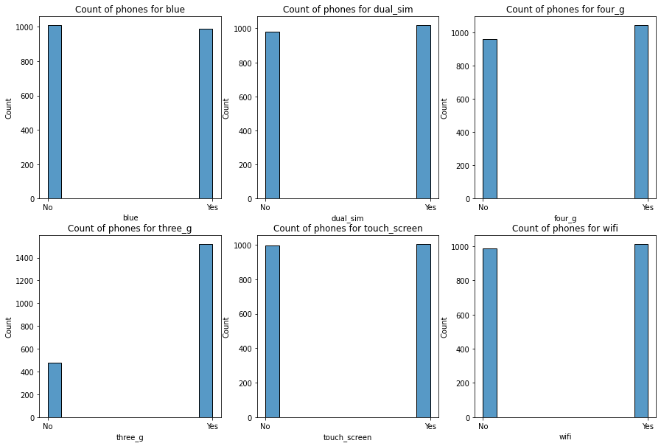
EDA - Univariate analysis
Price_range has equal no of observations
Except 3g, other dichotomous types have equal no of observations

Slide 9
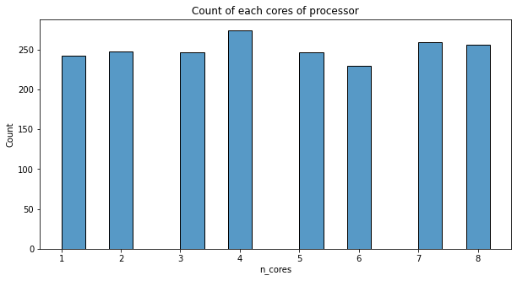
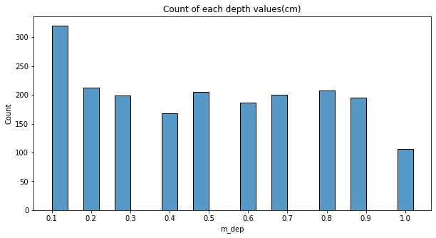
EDA - Univariate analysis
Most Equal no. of observations, highest being 4 cores
0.1cm has highest and 1cm has least no. of
observations.

Slide 10
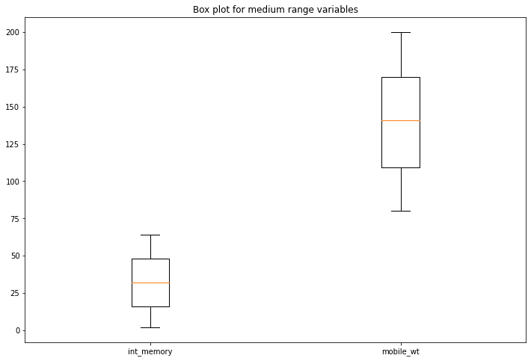
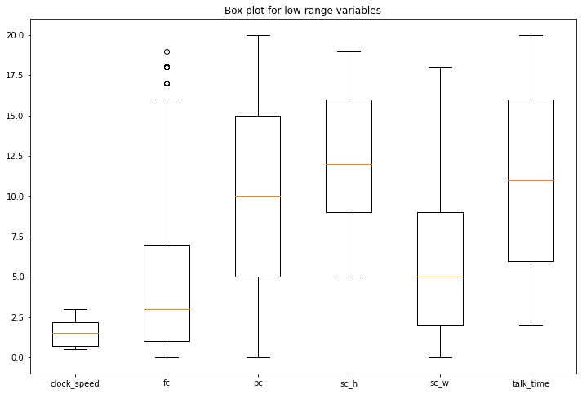
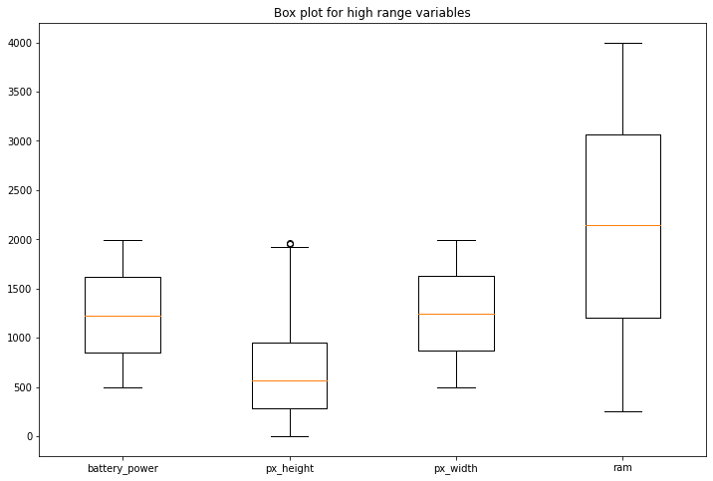
Univariate analysis - Numerical Variable Descriptive stats using boxplots

Slide 11
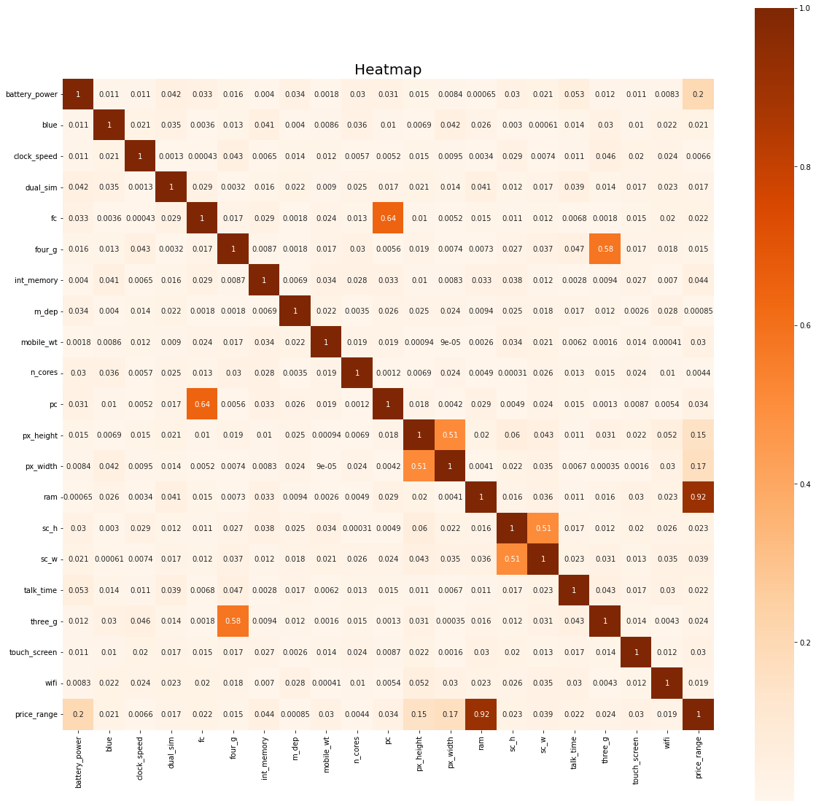
Multivariate analysis
● Pc is correlated with Fc.
● px_height and px_width are moderately correlated.
● Sc_h and sc_w are moderately correlated.
● Ram is highly correlated with price_range.

Slide 12
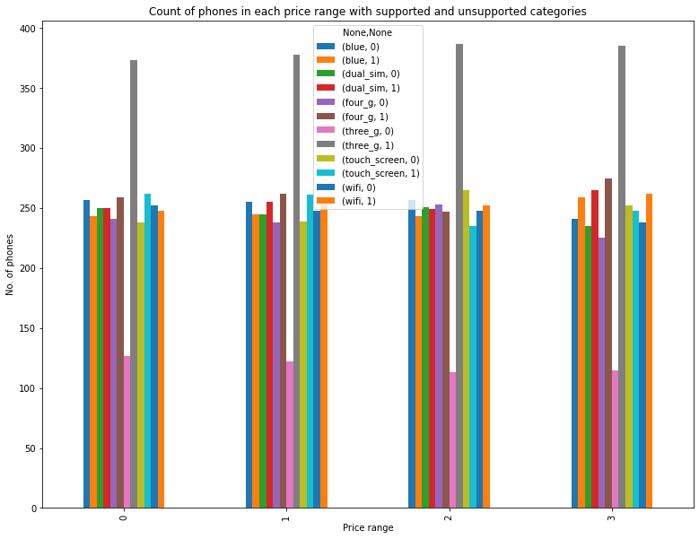
Multivariate analysis - Categorical variables
Almost equal no. of observations for each price range for each category.

Slide 13
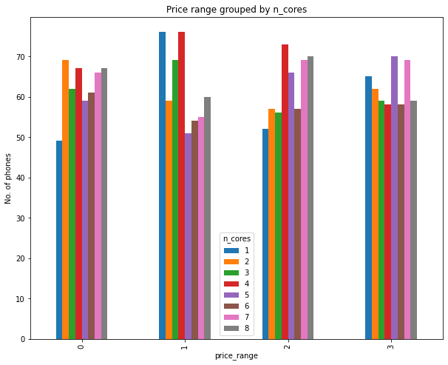
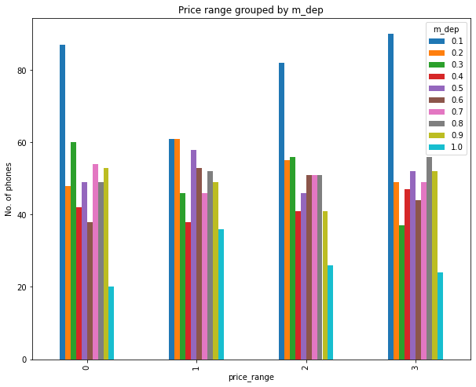
Multivariate analysis - n_cores & m_dep
Count of phones with n_cores for each price range
Count of phones with m_dep for each price range

Slide 14
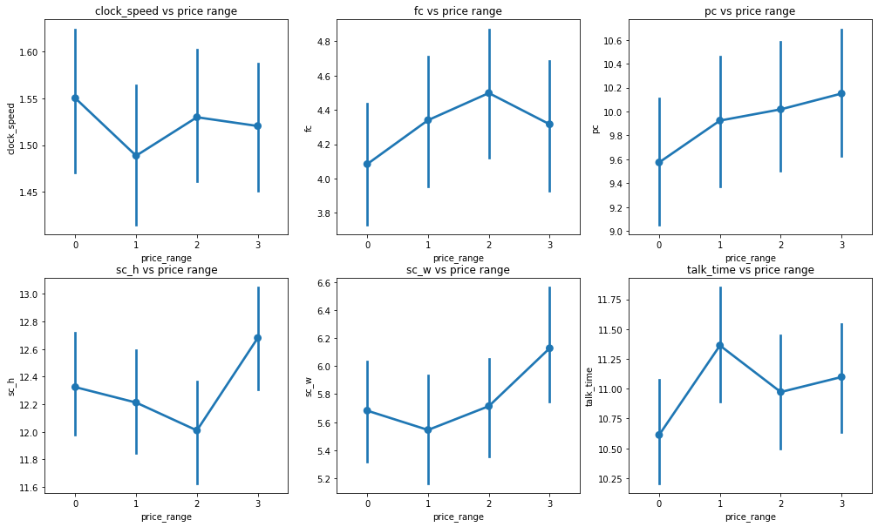
Multivariate analysis - Numerical variables
● Clock_speed is high for low price range phones , talk_time is also less. ● Pc, fc, sc_w are in increasing trend.

Slide 15
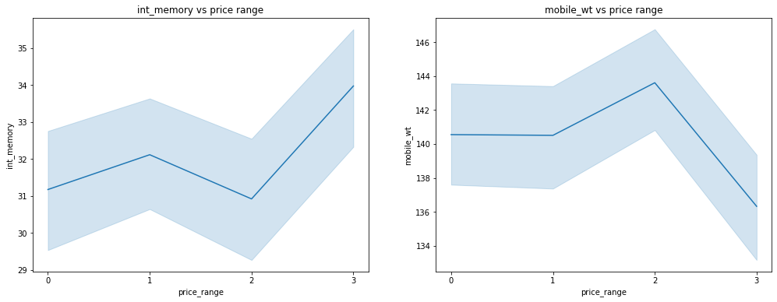
Multivariate analysis - int_memory, mobile_wt
Increase in internal memory for very high prices
Decrease in mobile weight for very high prices

Slide 16
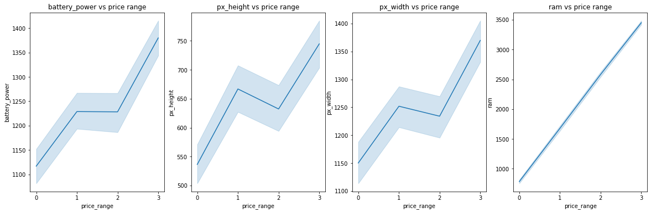
Multivariate analysis - Continued
The battery life dramatically increases with the price range.
Pixel height and width are also varying with price range.

Slide 17
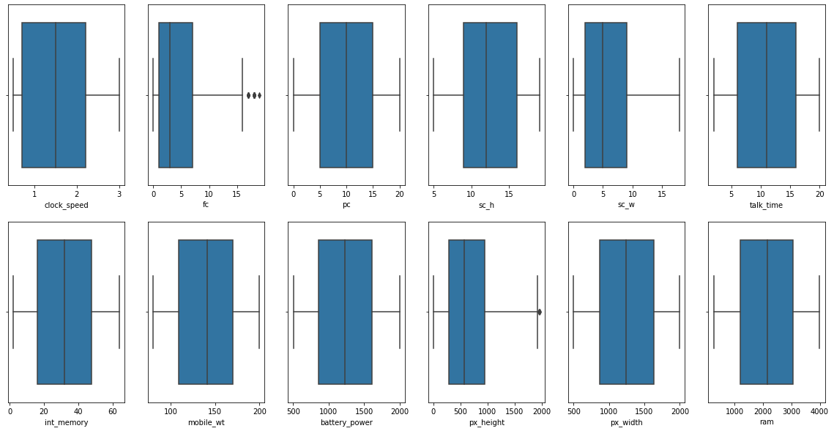
Data Wrangling
● No null values.
● Outliers were close to
maximum value, so they can be ignored.

Slide 18

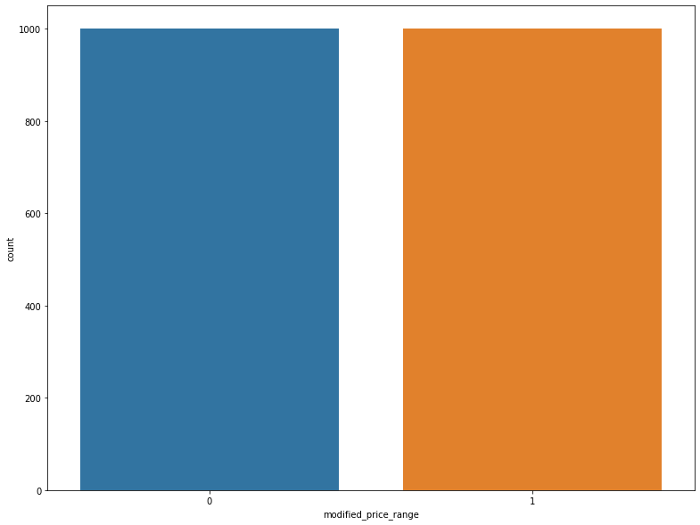
Converting the dependent variable to a binary variable
Converted the dependent variable into two classes i.e ‘0’ and ‘1’.

Slide 19
Splitting data into train and test Data sets
1. Converted the Data into train and test Data sets.
2. Took 80 percent of the data as Training data.
3. Took rest 20 percent of the data as Testing Data.
4. Took the random state as zero.
5. As our data have over fitting when passed through the model, We have used
the hyper parameter tuning.

Slide 20
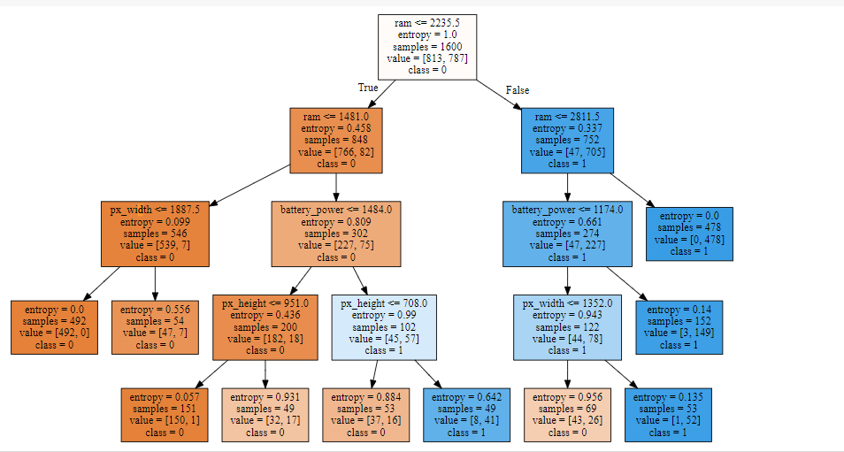
Decision Tree
The above diagram is the visual representation of the decision tree where it can be understood for a layman also how the system came to a particular prediction of a class

Slide 21
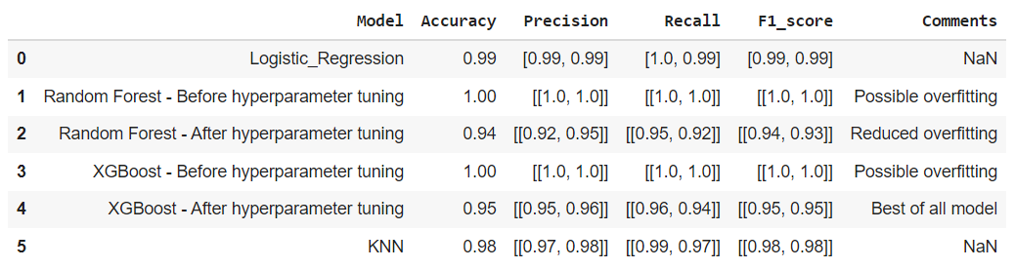
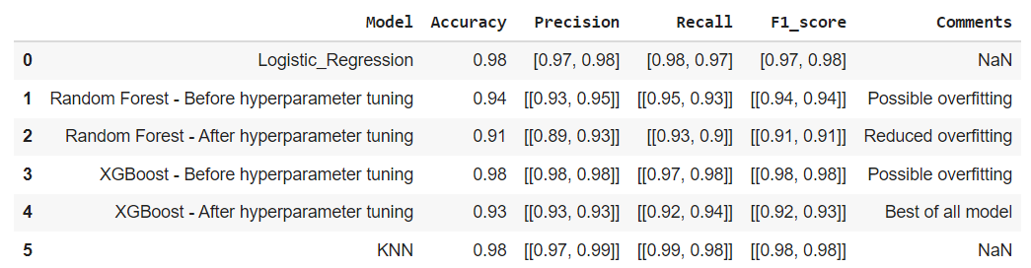
Machine Learning Models
Training Set
Test Set

Slide 22
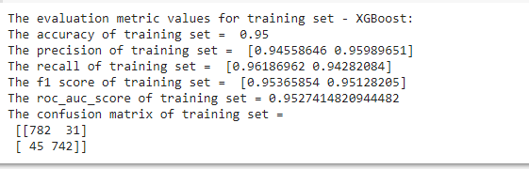
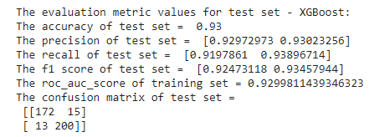
Applying Model (Baseline Model)

Slide 23

Model Validation & Selection(continued)
We had chosen XG Boost Classifier for our
prediction and the best hyperparameters
obtained are as below.
gamma: 1,
learning_rate: 0.13,
max_depth: 13,
min_child_weight: 10,
n_estimators: 13,
subsample: 0.5

Slide 24
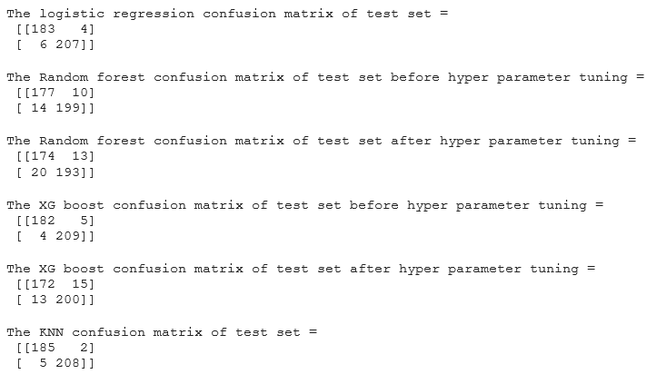
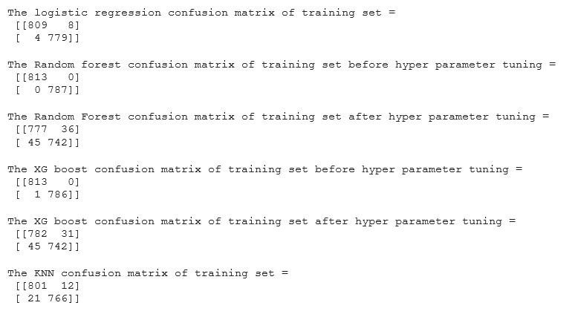
Test Data
Train Data

Slide 25
Model selection and validation
● Random Forest and XGBoost initially overfitted with default hyperparameters.
● Overfitting was tackled with the help of hyperparameter tuning using Random Search.
● The best performance was given by XGBoost model, with accuracy of 0.95 and 0.93 for training and test set respectively.

Slide 26
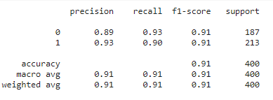
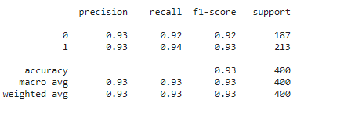
Model Validation & Selection(Hyperparameter tuned)
Random forest classifier
XG Boost classifier

Slide 27
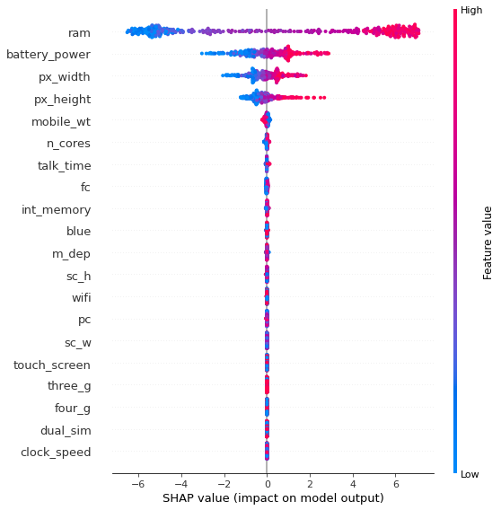
Impact columns on model output

Slide 28
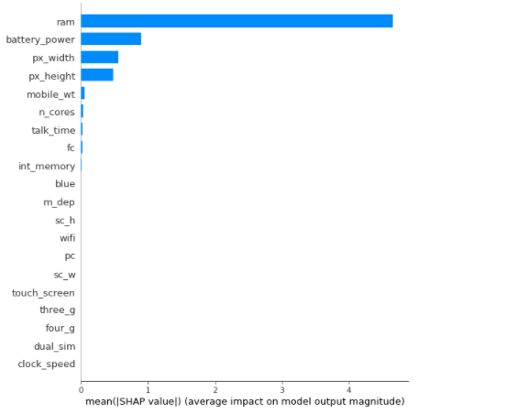
Feature Importance

Slide 29
Challenges
● The most challenging part in this exercise was to find an optimal set of hyperparameters that could give us the best performance.
● It took hours to try every combinations and finally selecting the best values.
● The model could even perform better with finer tunings and more number of instances.

Slide 30
Conclusion
● We build a predictive model, which could help companies to estimate price of mobiles in much effective way.
● To predict the cost of various different types of products, same procedure can be performed.
● By specifying economic range, a good product can be suggested to a customer.

Slide 31


